Slide 1
MINEWAY SURFER
06/12/2022
X
Produced by Chloé Becker, Tom Collange, Clément Coutant, Cyrian Crusson, Jérémie Degorce-Dumas, Guillaume Deschamps, Fabien Mucret and Tanguy Perot

Slide 2

IOT, what is it?

Slide 3
TABLE OF CONTENTS
1
4
Sensors and electronics
Modeling and 3D printing
2
Game design
3
Environments and 3D models

Slide 4

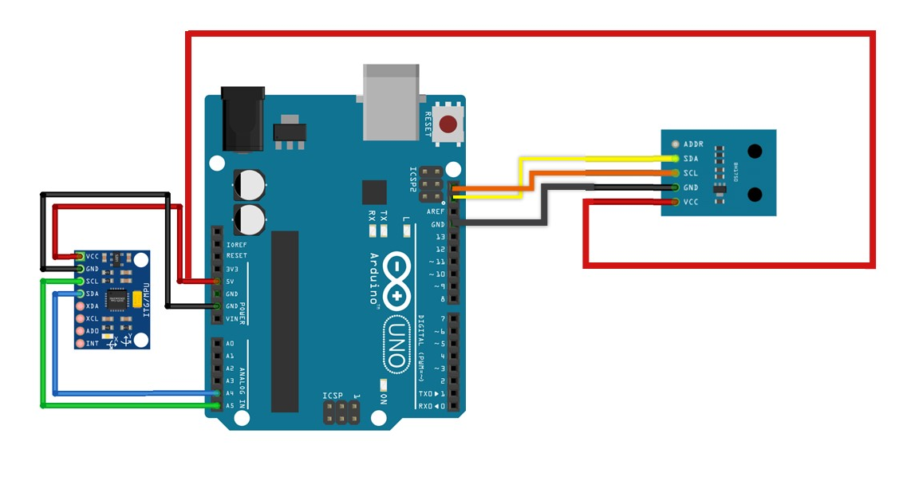
Sensors and electronics

Slide 5
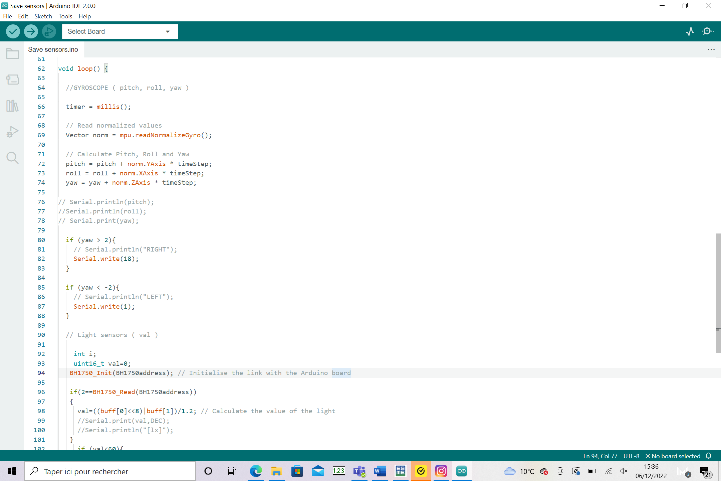
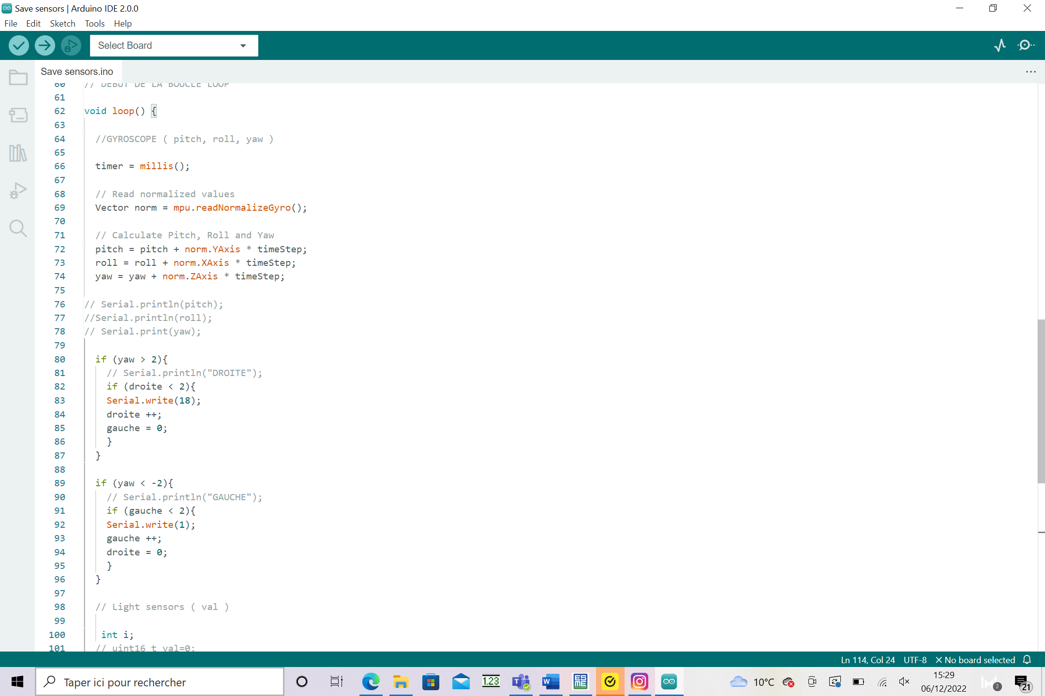

Arduino code : Gyroscope

Slide 6
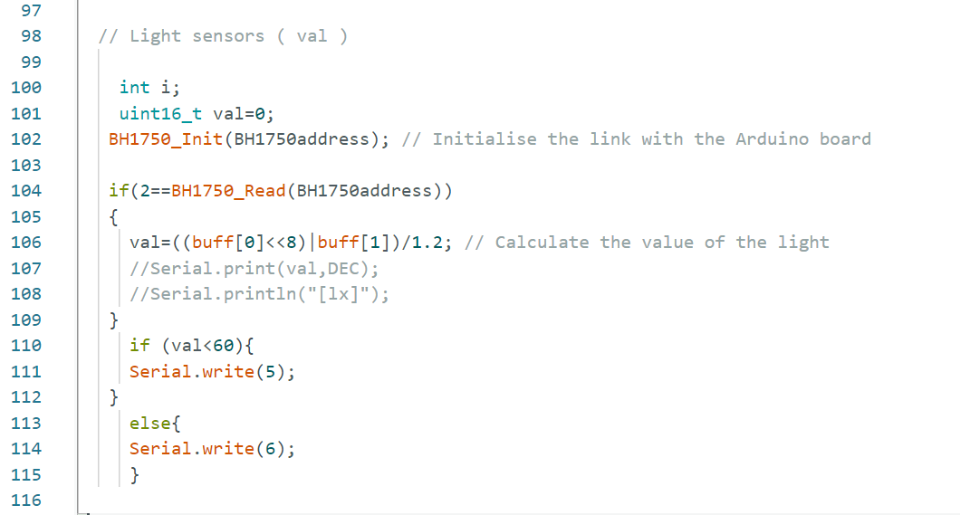
Arduino code : Light sensor

Slide 7
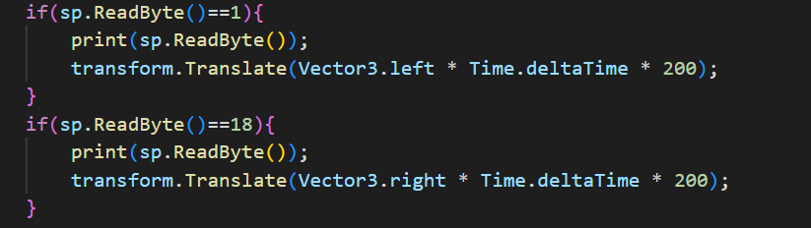
C# code

Slide 8

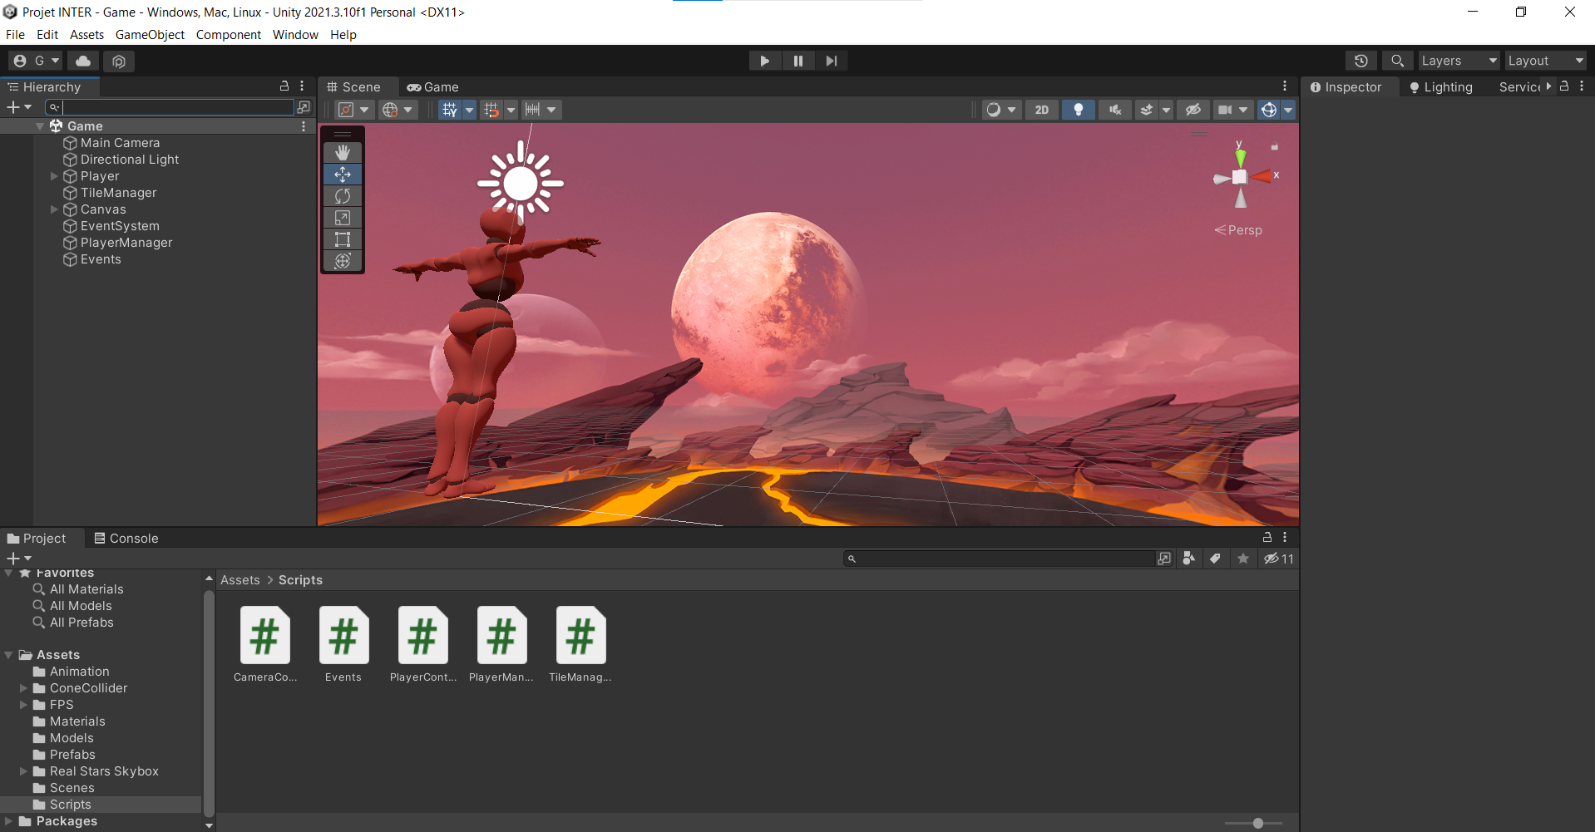

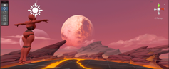
Game DESIGN
X
Mineway Surfer prototype

Slide 9
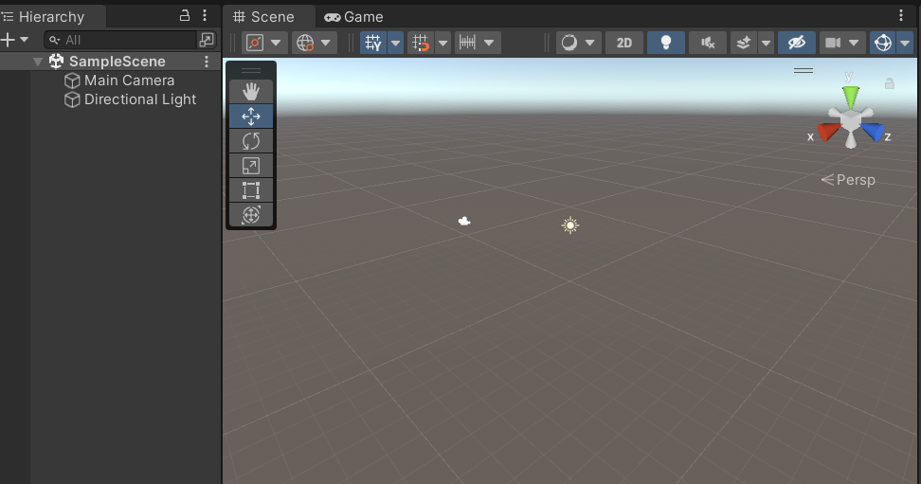
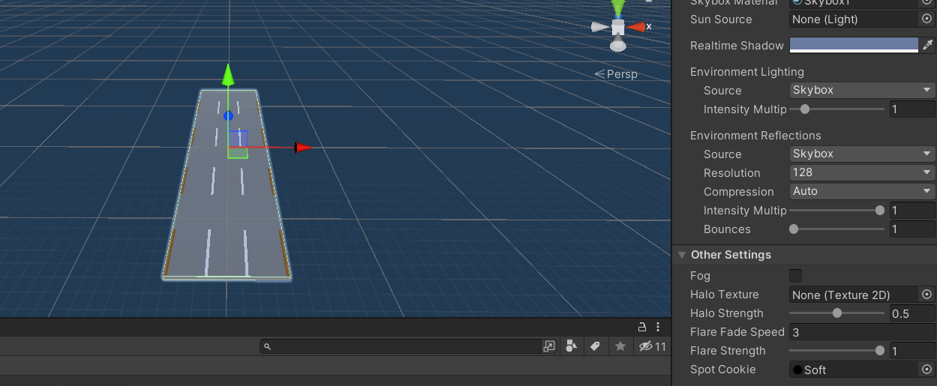
Unity
What is it ?
2D/3D engine and framework
Supports most formats
Allows imports of many assets
Eases object control
What did we learn ?
Manipulate an object
Generating a random cycle
Creating a game START/OVER panel
Making a game is not as easy as it sounds

Slide 10


VS Code
VS Code
Bugs
Open-source code editor
Squashed
Unity
C#
Runtime
Programming language

Slide 11
The link between vs code and unity
Unity plug in:
1. VS code as default editor
2. Open unity in correct context
3. Omnisharp work with it
4. configures Vs code to ignore certain Unity file type
5. Create a launch file to enable debugging
Code completion (IntelliSense) in VS code
Windows developper pack / macOS SDK

Slide 12
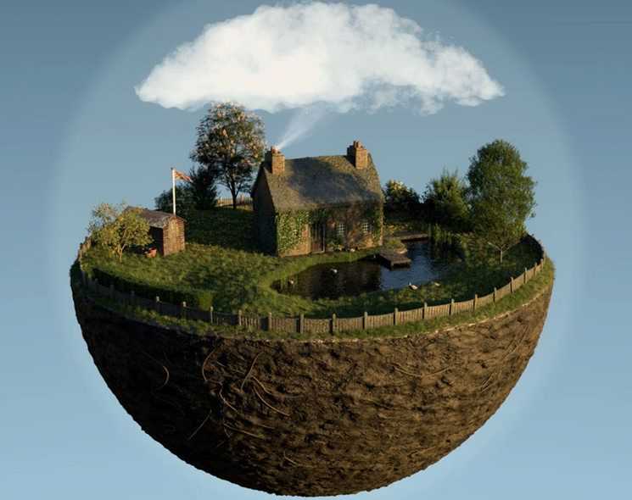

Environments & 3d Models
Made on :

Slide 13

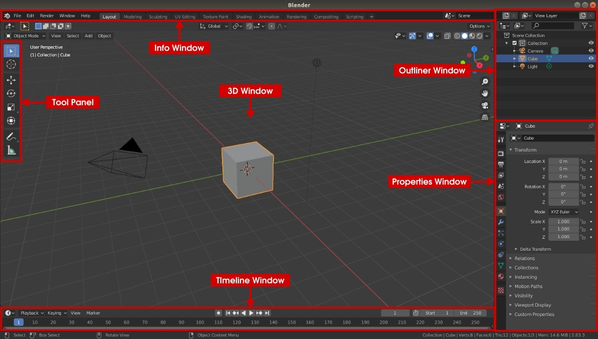
Blender

Slide 14
Features
Modelling
Animation
Sculpting
Rendering
Simulation
Texturing and shading
1
4
2
5
3
6

Slide 15
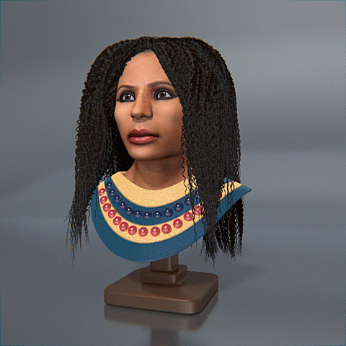
Modelling & Sculpting

Slide 16
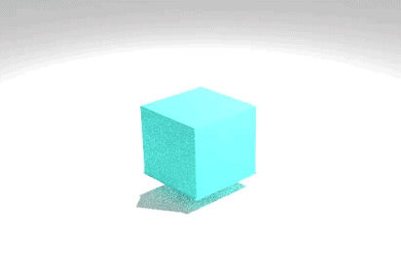
Simulation

Slide 17
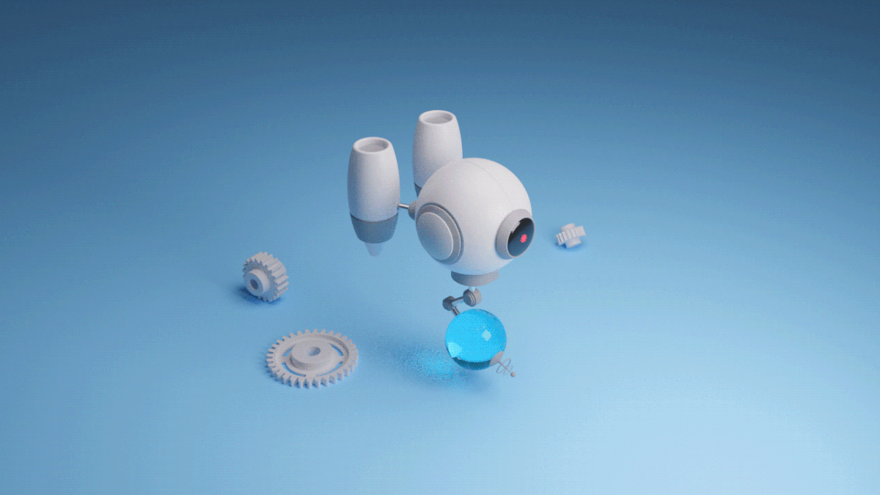
Animation

Slide 18
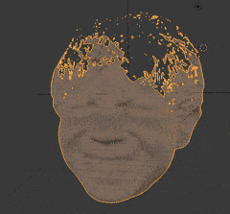
Rendering

Slide 19




3d objects Library

Slide 20
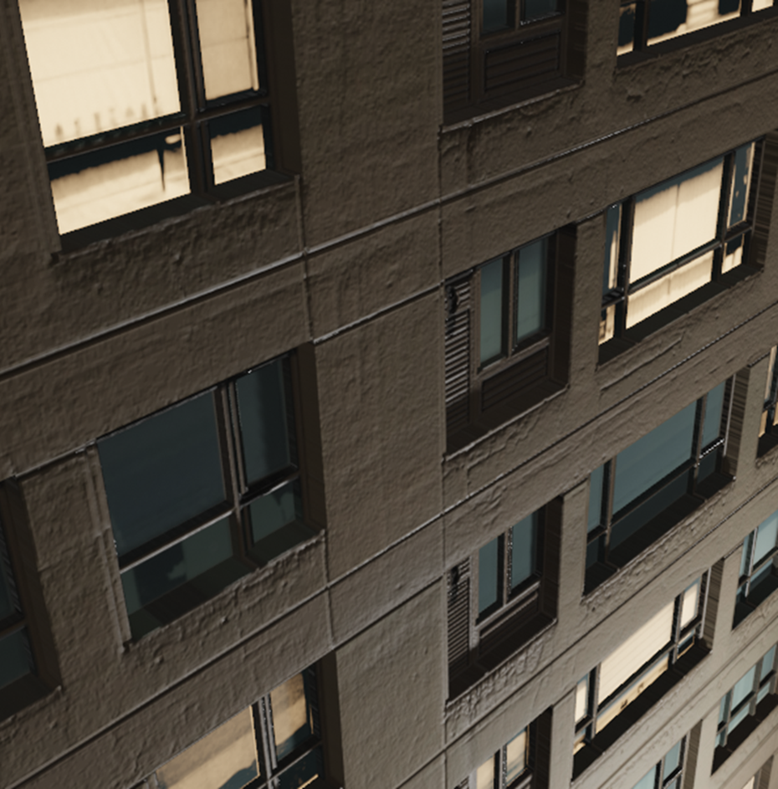
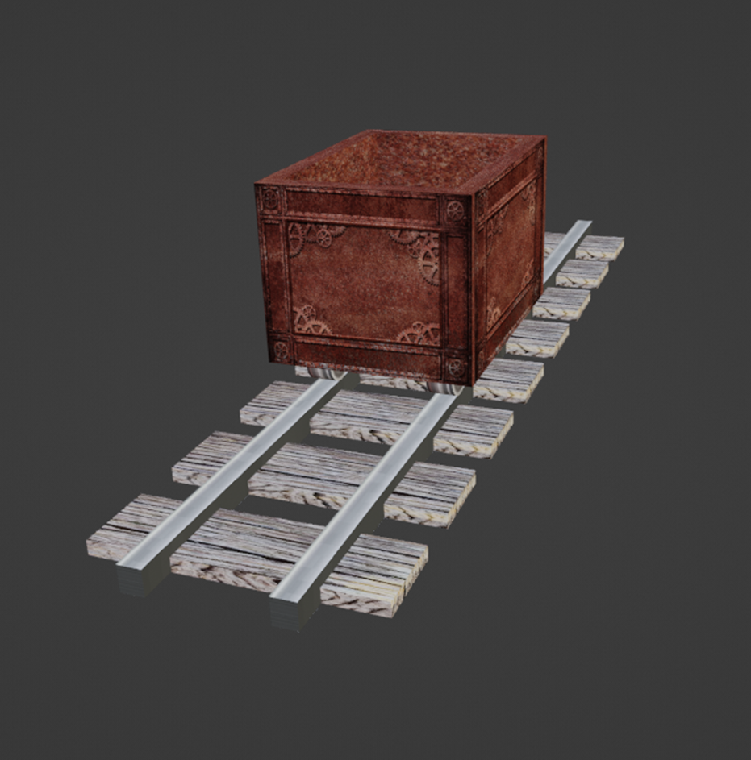

Slide 21
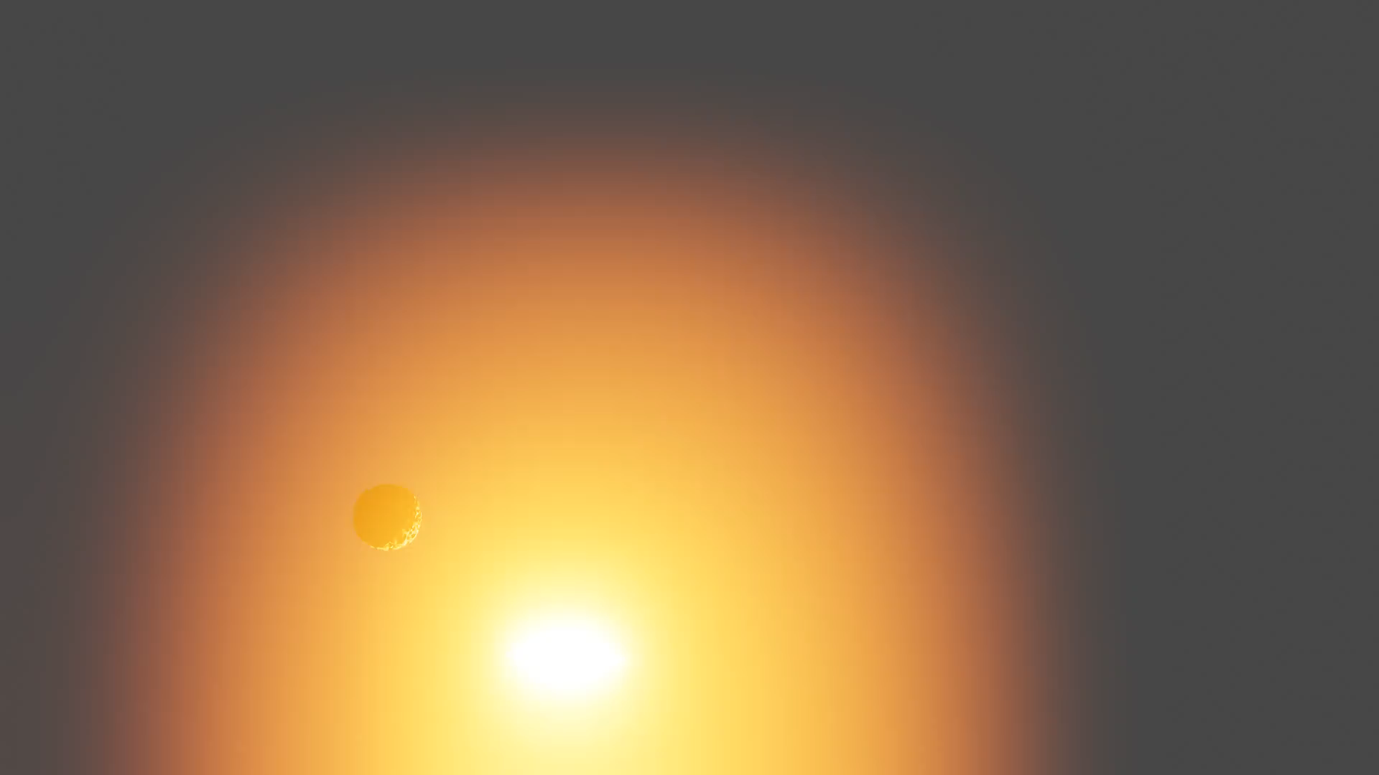

Slide 22

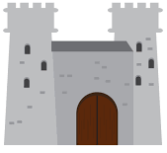


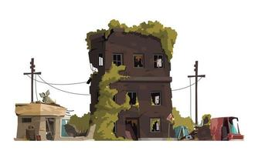
World themes
Child’s bedroom
Space
Medieval castle
Apocalypse city
Farm

Slide 23
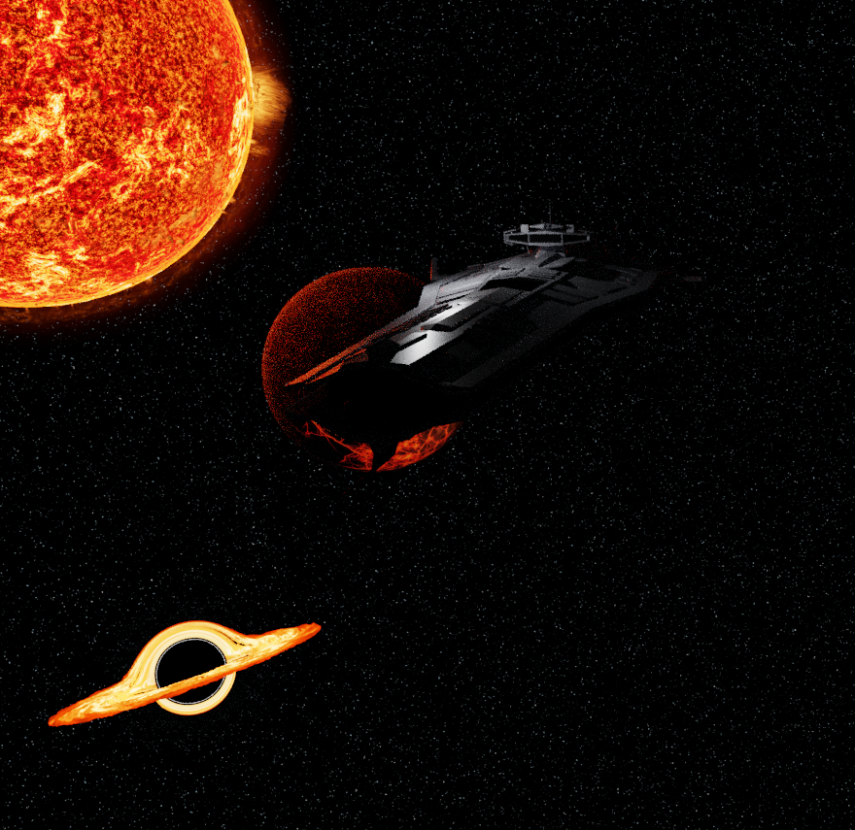
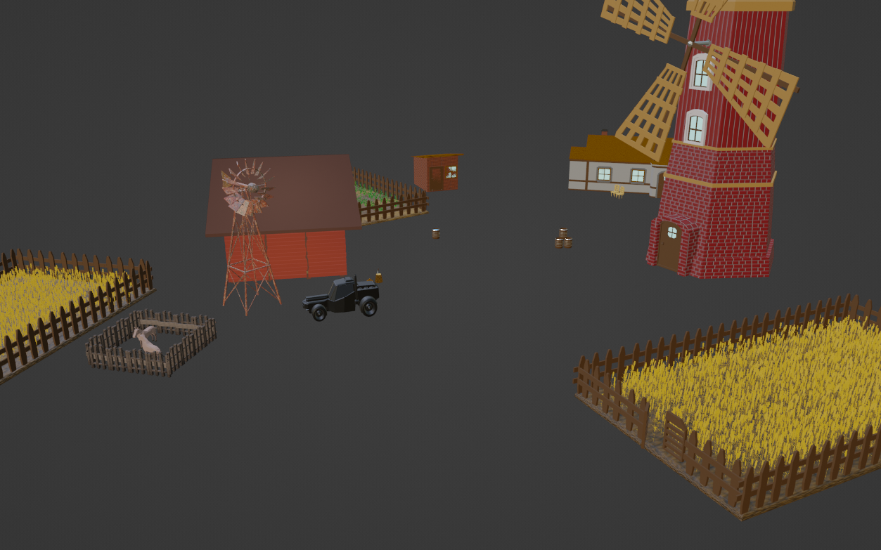
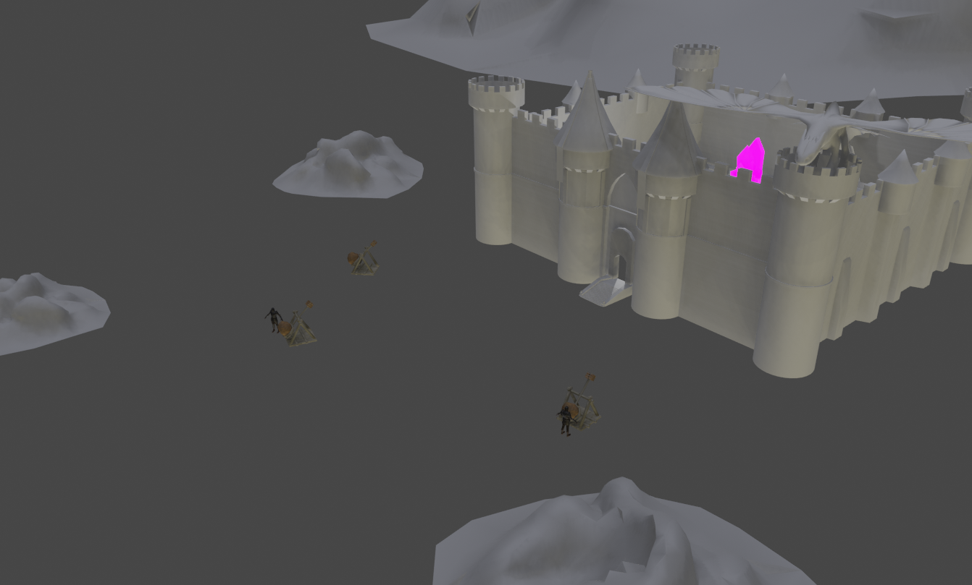
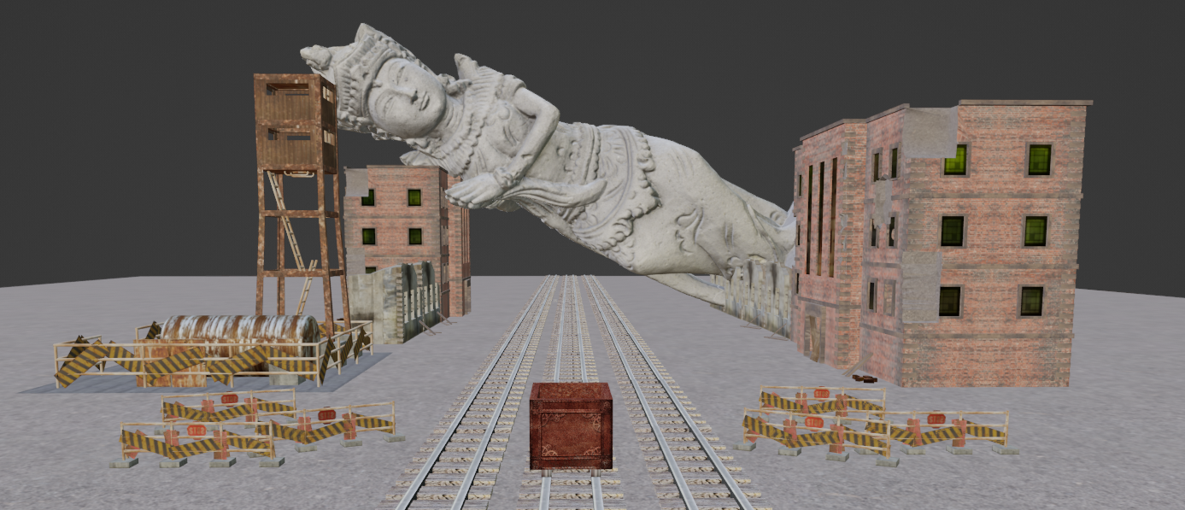
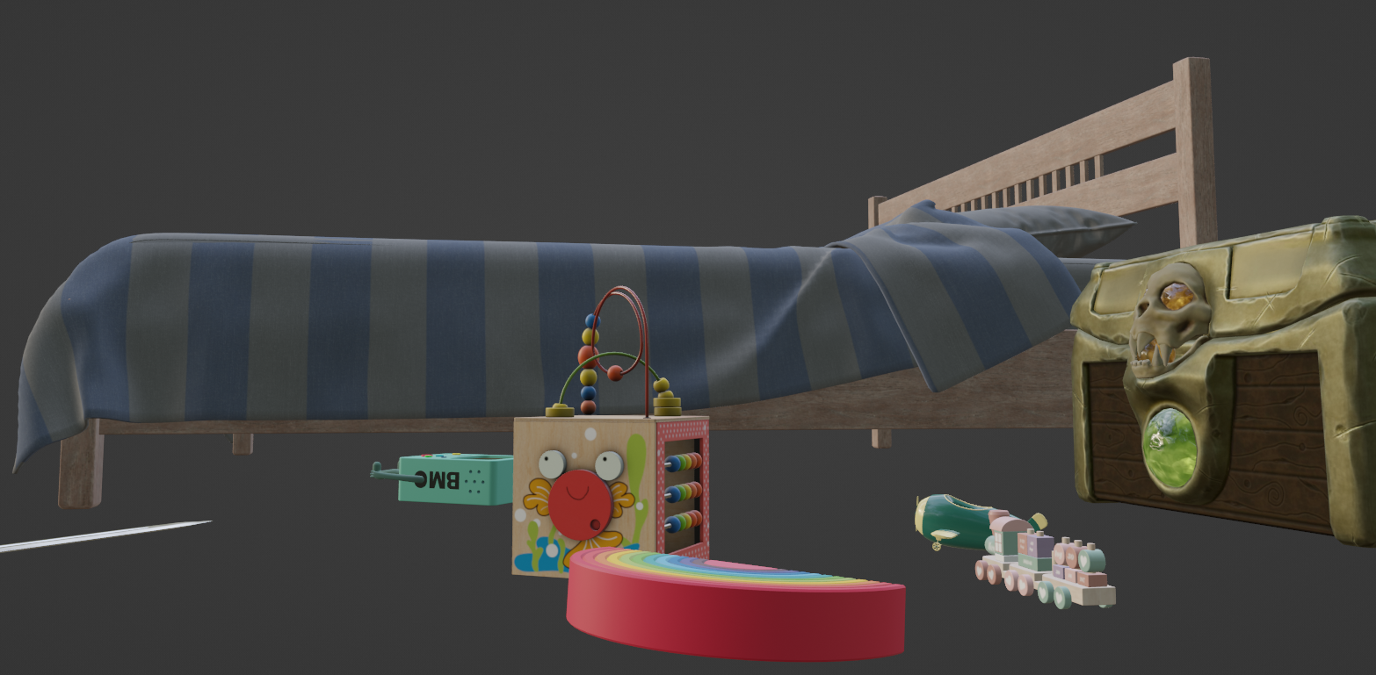
Worlds made

Slide 24
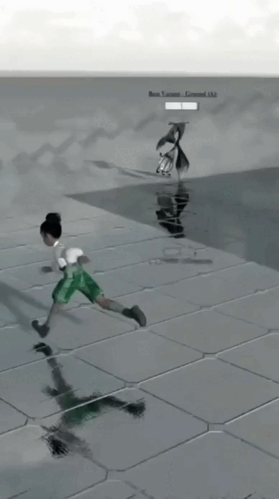
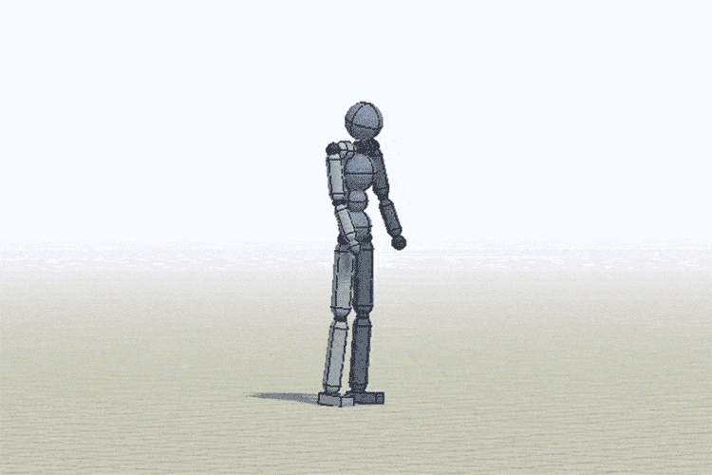
Blender team horizons

Slide 25
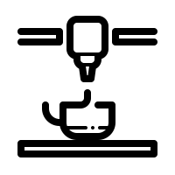
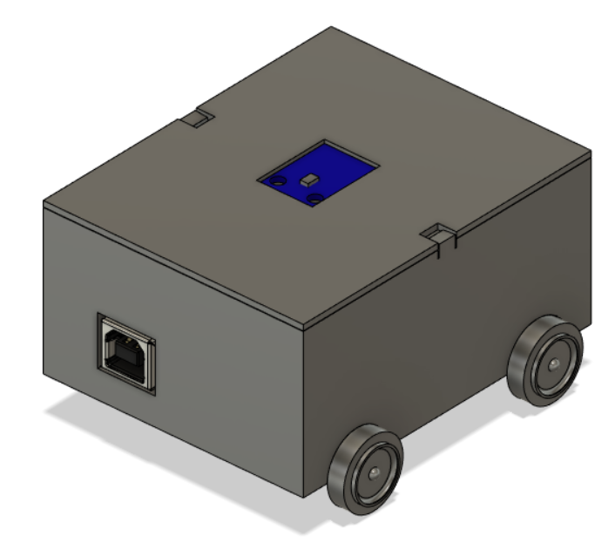
CAD Modeling​ and Printing
Steps:
Getting the source models
Understanding the functions of the object
Figuring out the size constraints
Making the model 3D-printable
Final version: V4.1

Slide 26
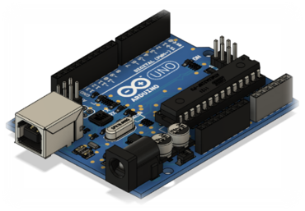
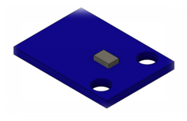
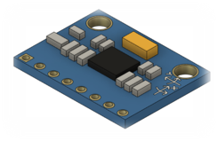
CAD Models
The parts were sourced from GrabCAD, a large model repository anything electrical and mechanical.
Light sensor
Gyroscope
Arduino UNO Model

Slide 27

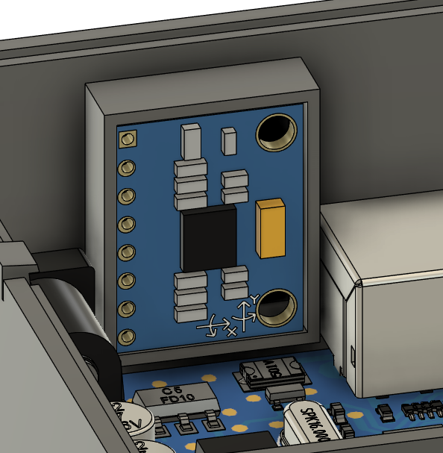
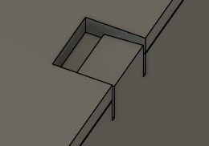
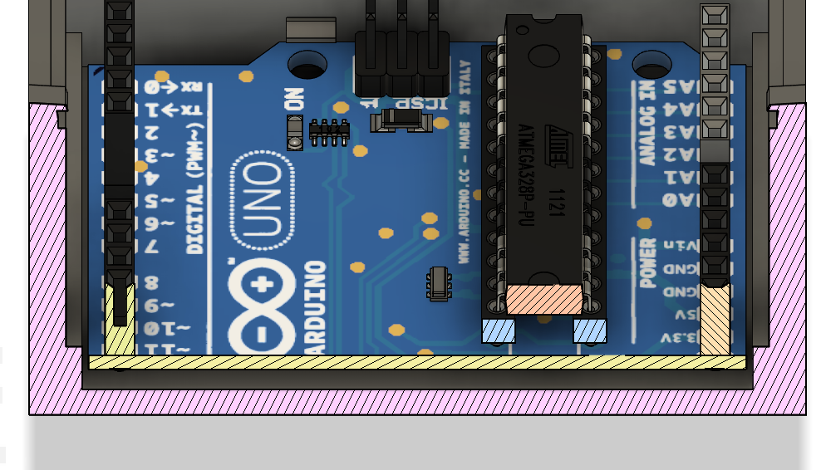
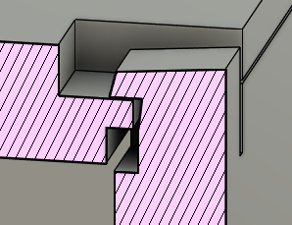
Modeling
Issue:
Gyroscope and light sensor not completely the right size
Solution:
Measure the sensors' dimensions and adjust
Issue:
Lid had no way to stay closed
Solution:
Integrate clips to hold the parts together
Issue:
Arduino kept sliding around inside
Solution:
Add rails to keep it centered

Slide 28
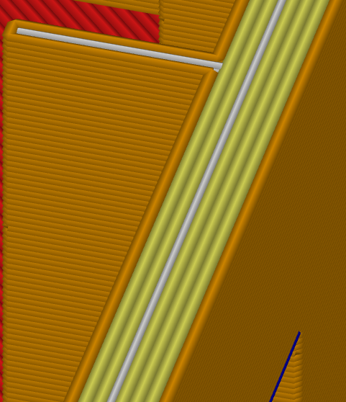
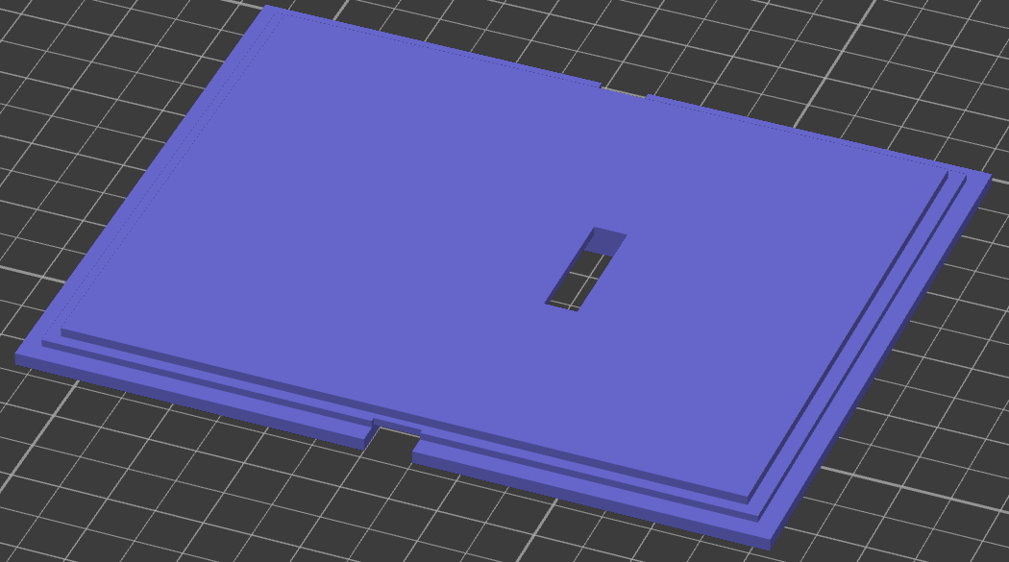
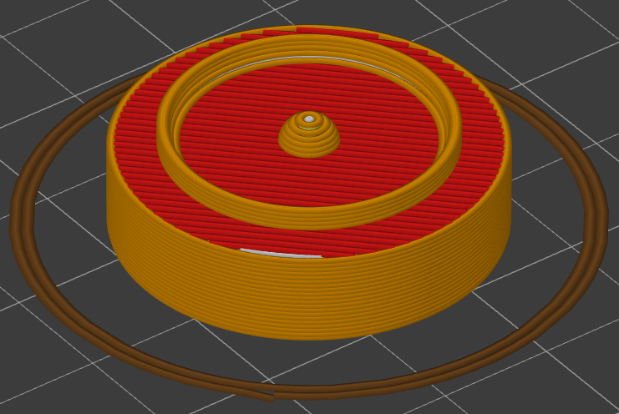
3D Printing
3 external perimeter for good structural strength
Parts as flat as possible to ease printing
Wheel printed four times

